Slide 2
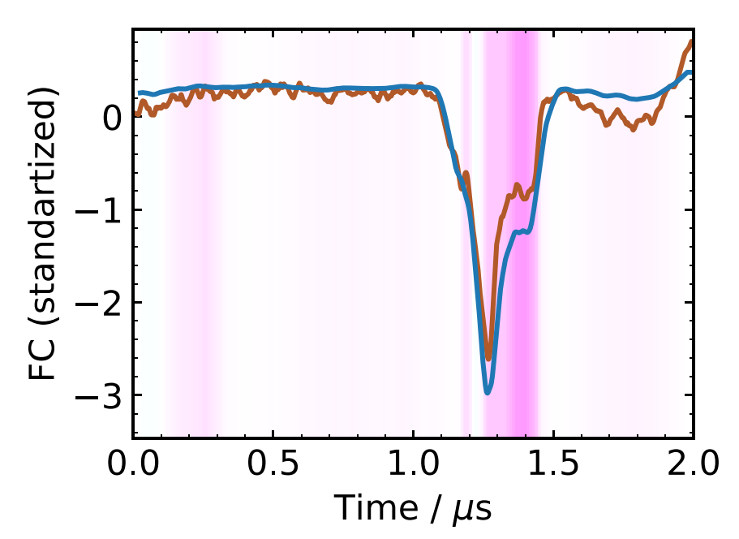
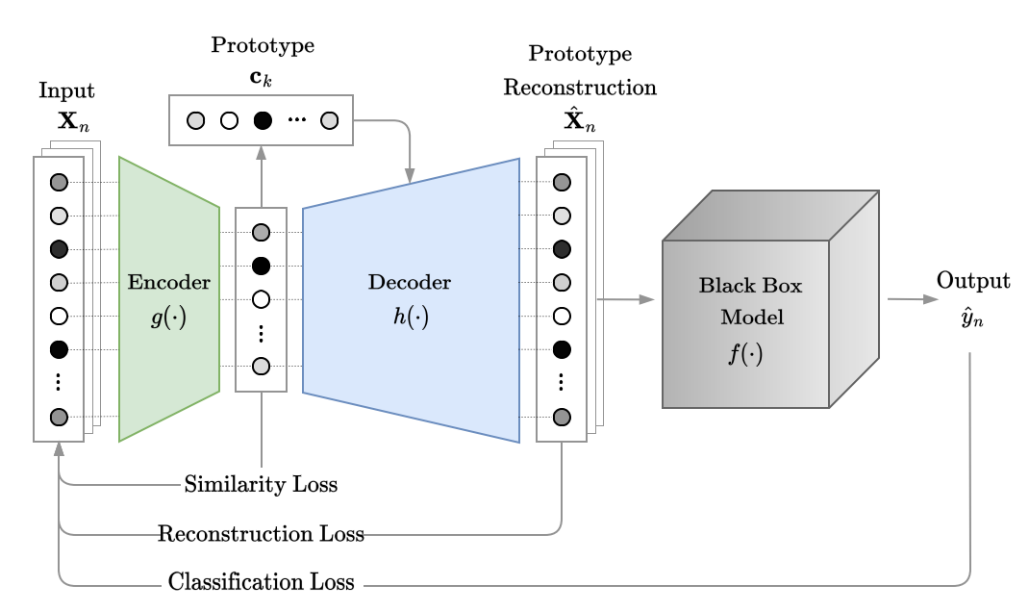
My Ph.D.: Interpretable Fault Prediction
Ph.D. finish line: 19th of January
Main contribution:
Breakdown prediction in CLIC RF cavities
Field emitted current following an initial breakdown is related to the probability of another breakdown occurring
C. Obermair et al., “Explainable Machine Learning for Breakdown Prediction in High Gradient RF Cavities”, PRAB, 2022
Interpreting ML models for fault prediction
Novel method for explaining fault predictions with ML, evaluation with 75 people from CERN and TU Graz
C. Obermair et al., “Example or Prototype? Learning Concept-Based Explanations in Time-Series”, PMLR, 2022
Interpretable Anomaly Detection in the LHC Main Dipole Circuit
Understand normal behavior and detect non-normal behavior in voltage measured at the diode after a FPA
C. Obermair et al., “Interpretable Anomaly Detection in the LHC Main Dipole Circuits with Non-negative Matrix Factorization”, to be submitted to IEEE, 2024
No Breakdown in next pulse
Breakdown in next pulse

Slide 3
Interpretable Anomaly Detection in the LHC Main Dipole Circuit with Non-Negative Matrix Factorization
Christoph Obermair, TE-MPE-CB
Acknowledgement:
Andrea Apollonio, TE-MPE-CB
Zinour Charifoulline, TE-MPE-PE
Lukas Felsberger, TE-MPE-CB
Marvin Janitschke, TE-MPE-PE
Aleksandra Mnich, TE-MPE-CB
Franz Pernkopf, TU-Graz
Emmanuele Ravaioli, TE-MPE-PE
Arjan Verweij, TE-MPE-PE
Daniel Wollmann, TE-MPE-CB
Mariusz Wozniak, TE-MPE-PE

Slide 4
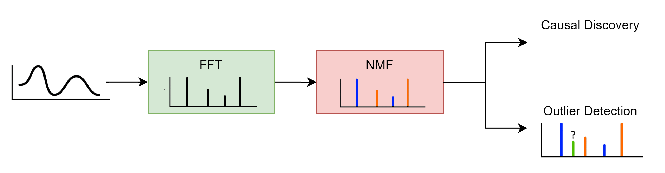
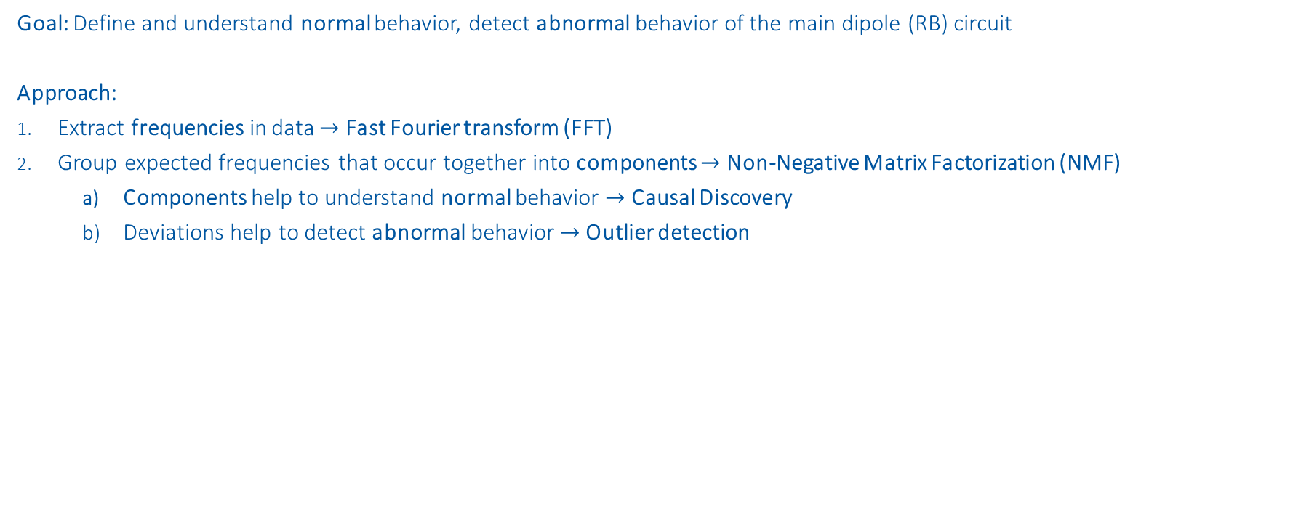
Outline
Goal: Define and understand normal behavior, detect abnormal behavior of the main dipole (RB) circuit
Approach:
Extract frequencies in data $→$ Fast Fourier transform (FFT)
Group expected frequencies that occur together into components $→$ Non-Negative Matrix Factorization (NMF)
Components help to understand normal behavior $→$ Causal Discovery
Deviations help to detect abnormal behavior $→$ Outlier detection

Slide 5
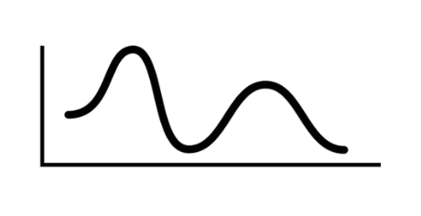
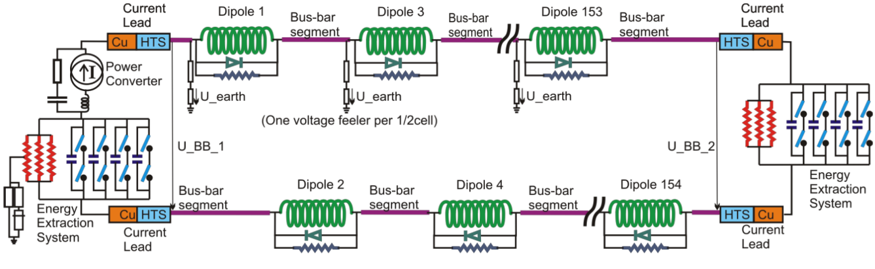
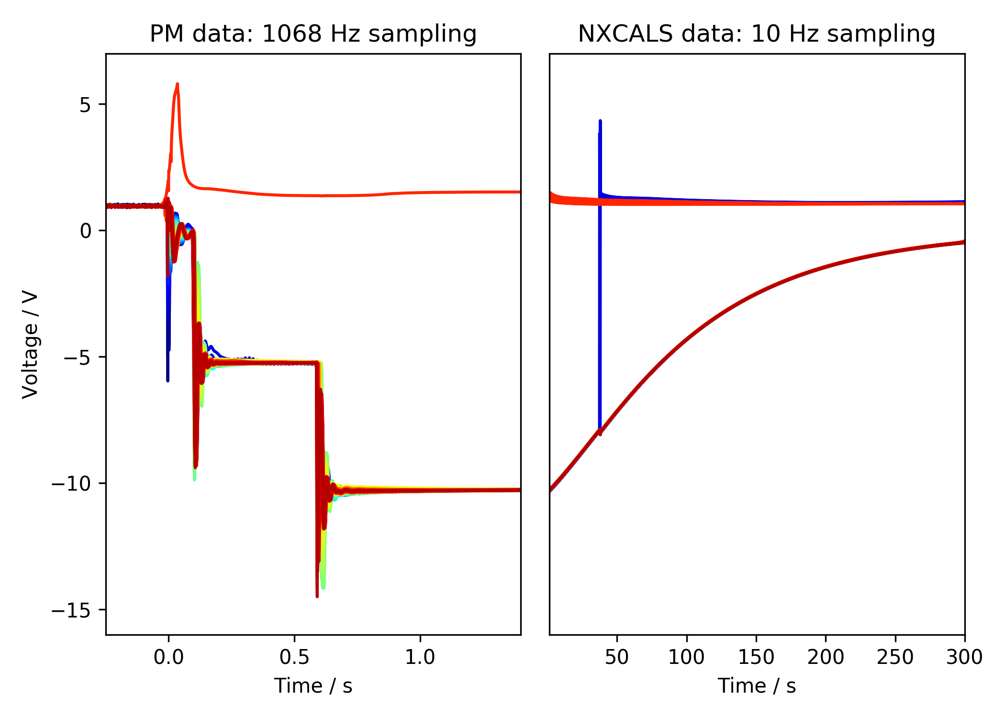
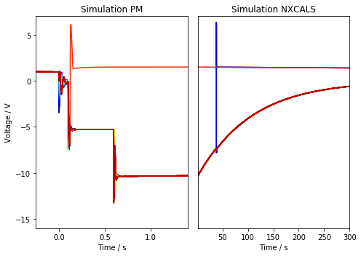
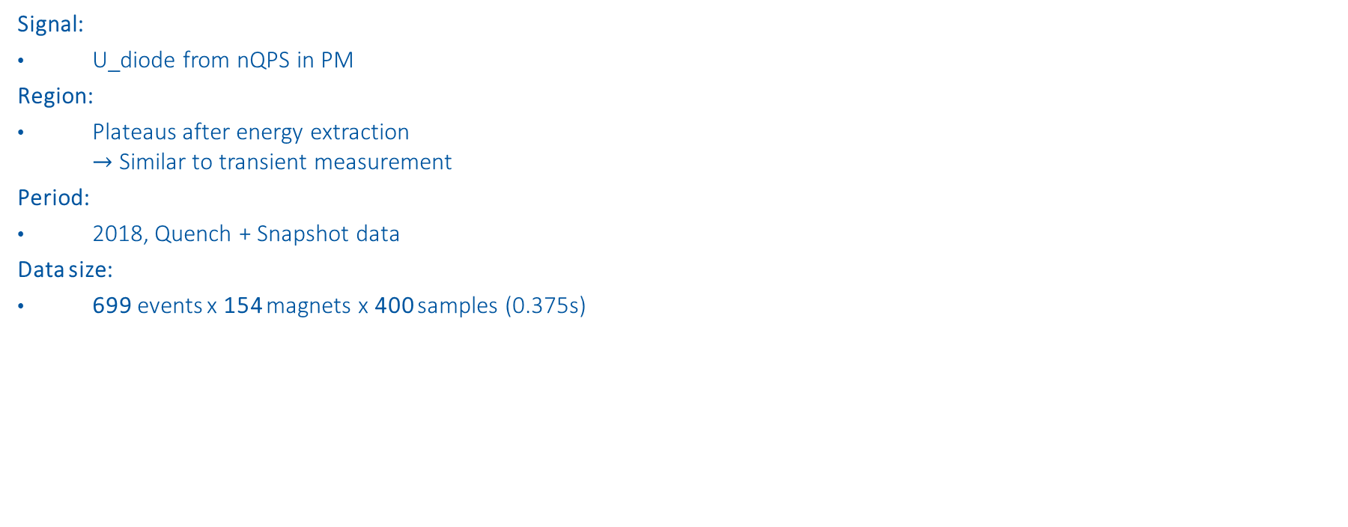
Select data
Signal:
U_diode from nQPS in PM
Region:
Plateaus after energy extraction $→$ Similar to transient measurement
Period:
2018, Quench + Snapshot data
Data size:
699 events x 154 magnets x 400 samples (0.375s)
1st EE
Plateau
2nd EE
Plateau
2nd EE switch off
*simulations done by Marvin Janitschke with STEAM framework
1st EE switch off
PC Switch off

Slide 6
Fast Fourier transform
Extract frequencies in data

Slide 7
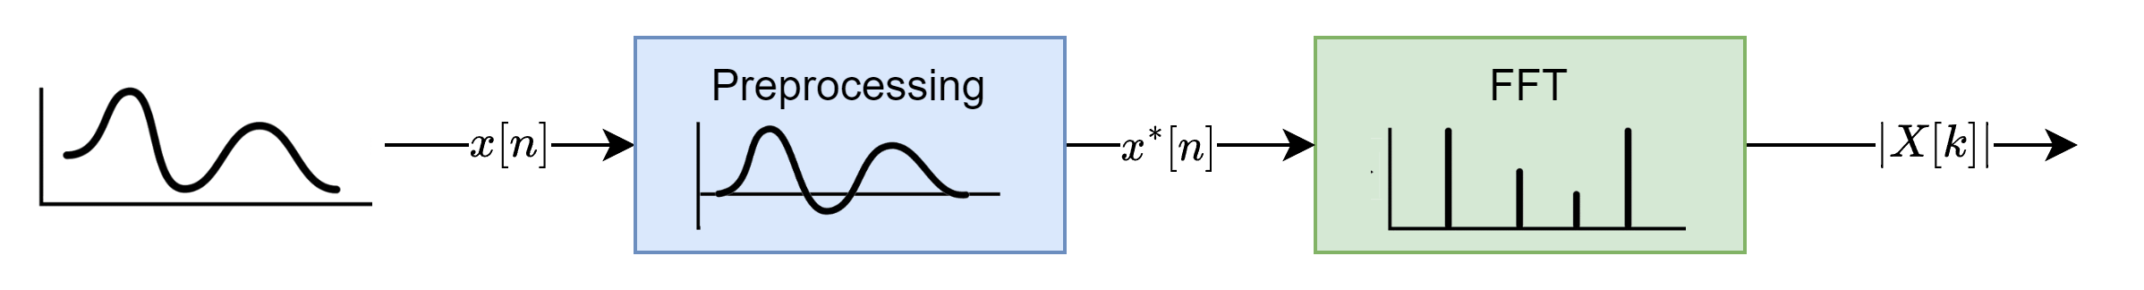
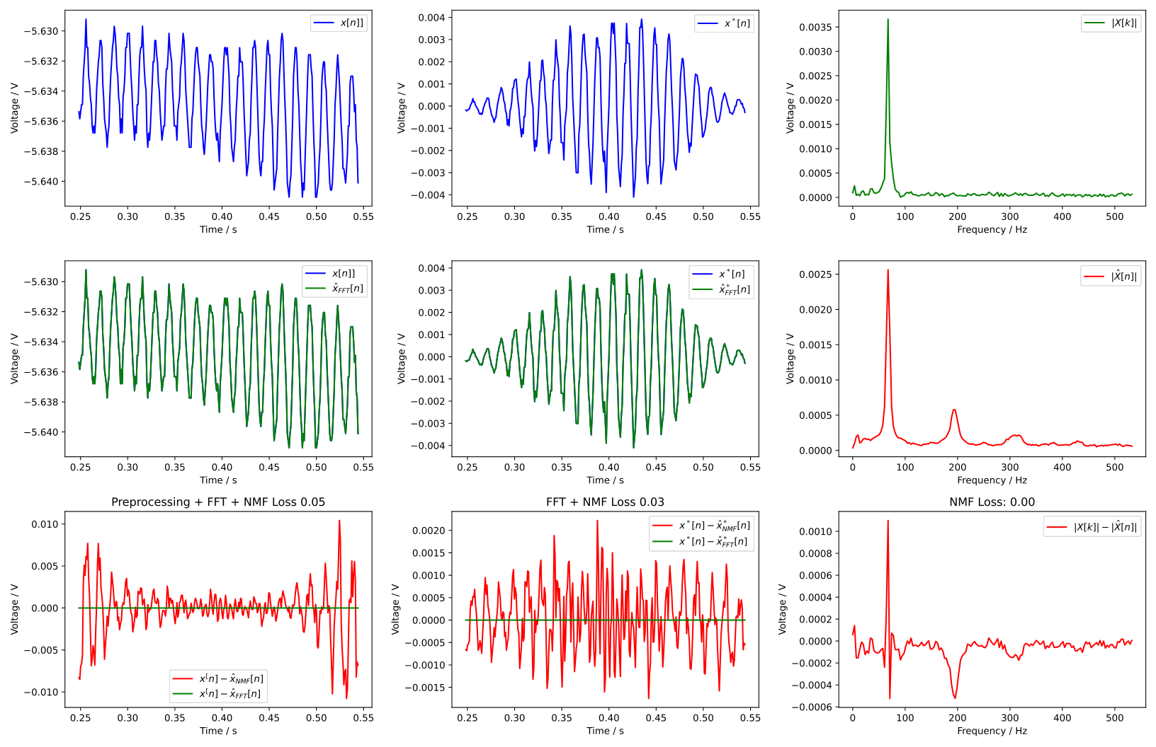
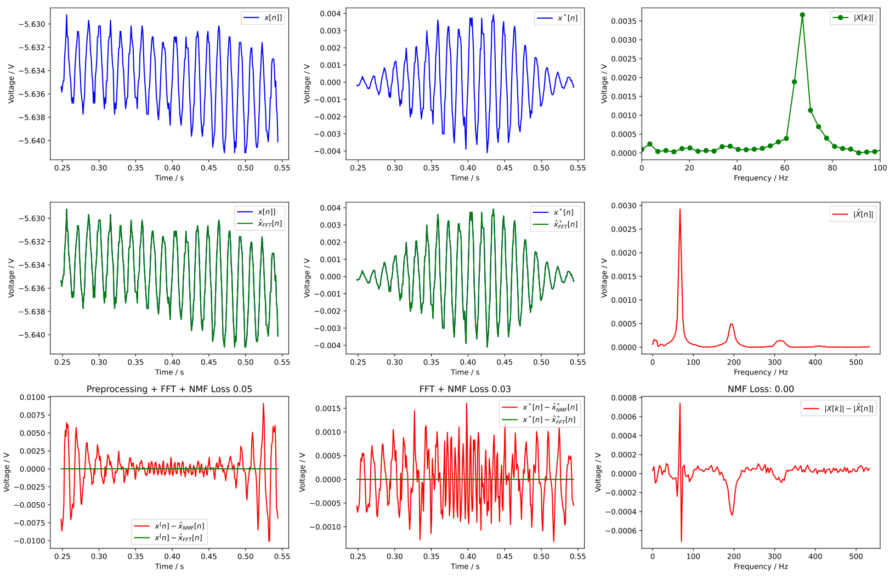
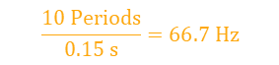

Fast Fourier transform
Example signal: B21R3 on 2021-04-18 08:44:17
Preprocessing necessary to minimize spectral leakage:
Subtract offset
Multiplication with window
$$\frac{10 Periods}{0.15 s}=66.7 Hz$$
$$67.4 Hz$$

Slide 8
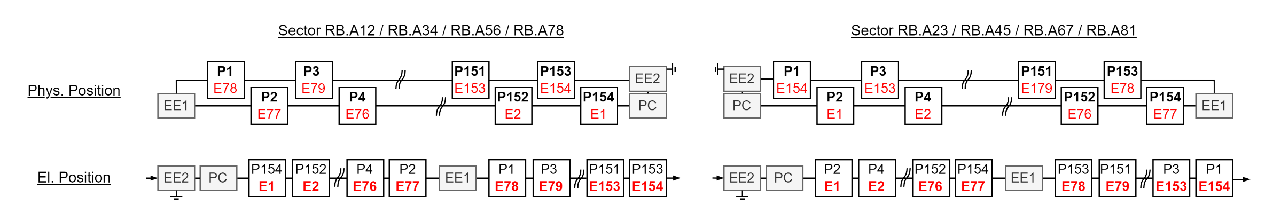
El. Vs Phys. Position

Slide 9
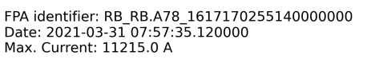
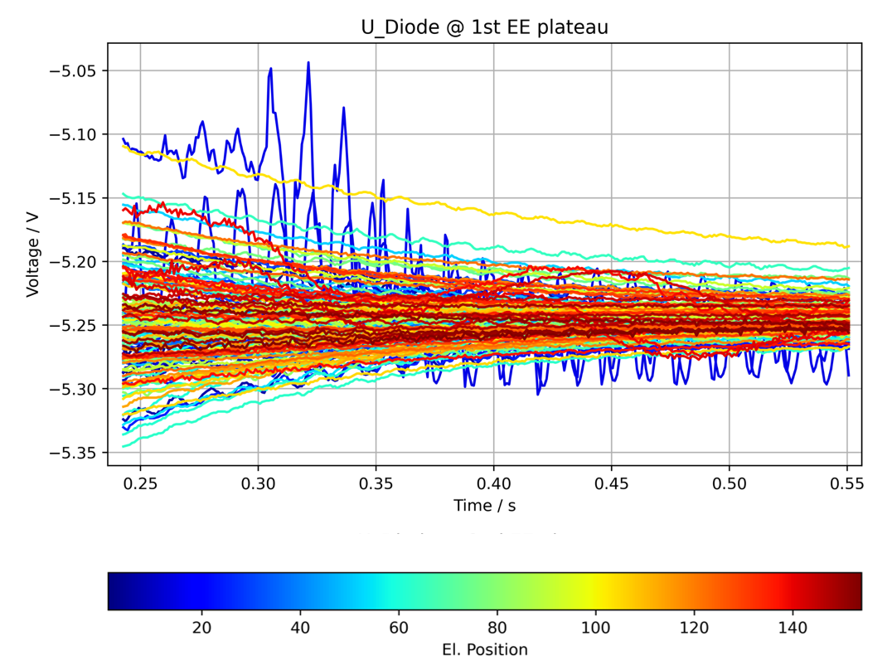
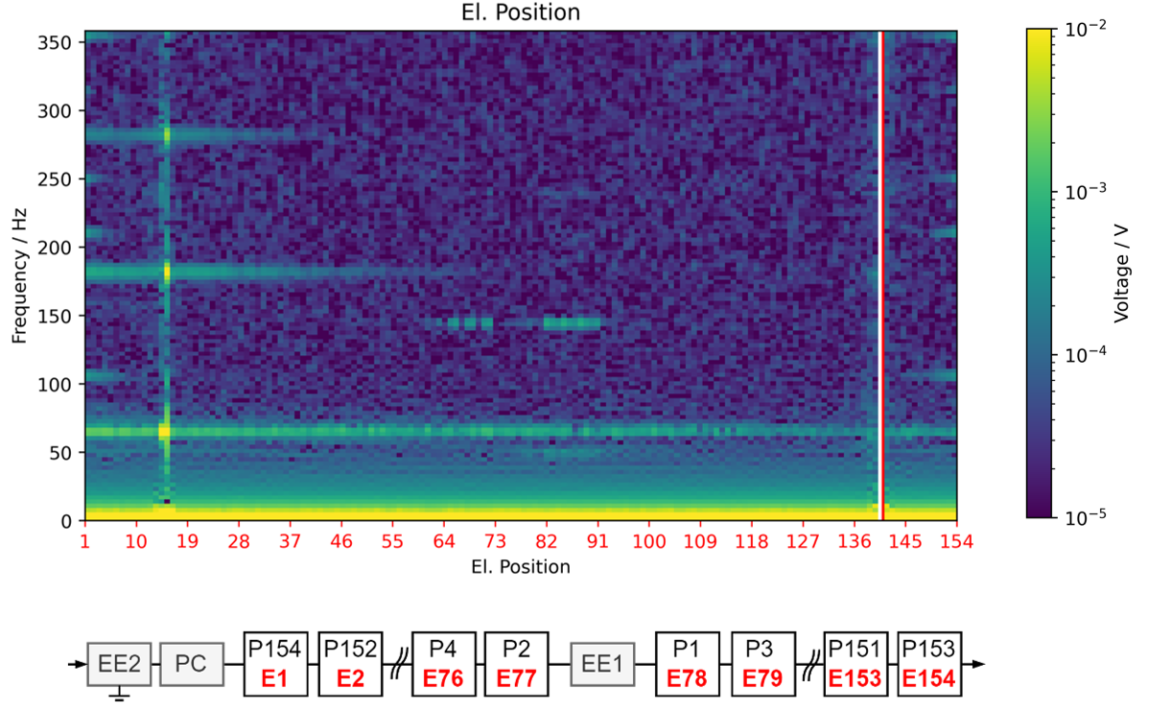
Frequency Position Maps (FPM)
Normal event
1st EE
Plateau
fft
2nd EE
Plateau
2nd EE switch off
1st EE switch off
PC Switch off

Slide 10
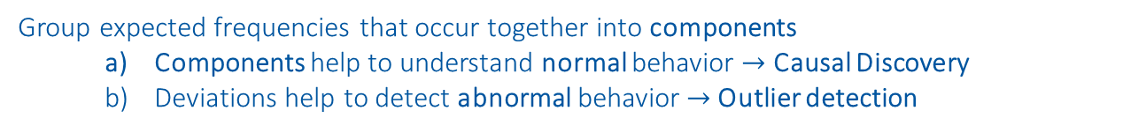
Non-Negative Matrix Factorization (NMF)
Group expected frequencies that occur together into components
Components help to understand normal behavior $→$ Causal Discovery
Deviations help to detect abnormal behavior $→$ Outlier detection
https://www.nature.com/articles/44565
https://proceedings.neurips.cc/paper/2000/file/f9d1152547c0bde01830b7e8bd60024c-Paper.pdf

Slide 11
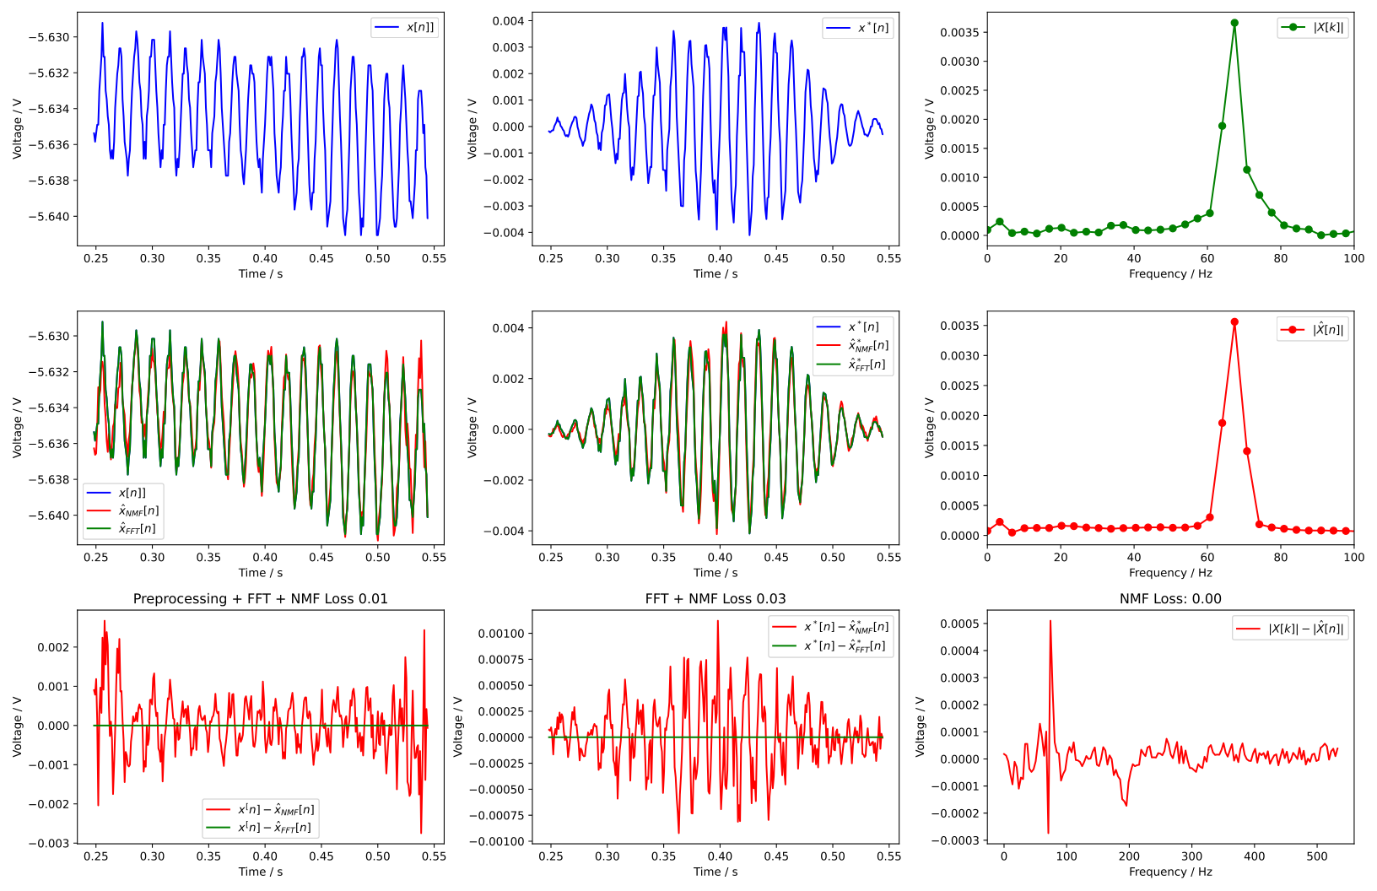
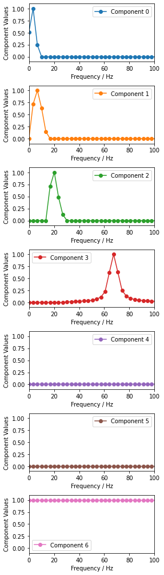
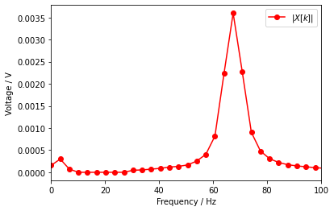

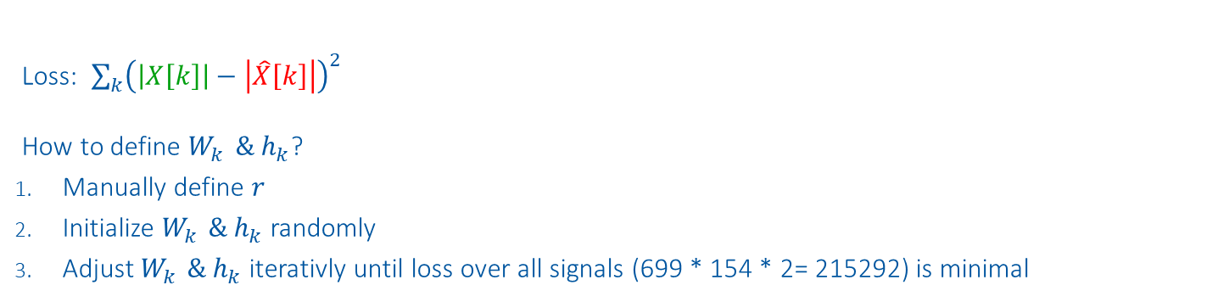
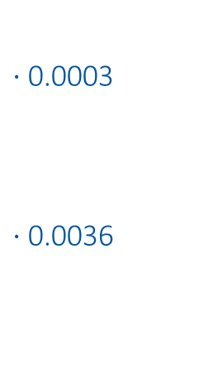
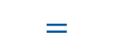
Method
Components
Weights
Input
Reconstruction
$$\left|X\left[k\right]\right| ≈ \sum_{k=1}^{r}{{ W}_{k }{⋅ h}_{k} = |\hat{X}[k]|}$$
$⋅$0.0003
$⋅$0.0036
$$≈$$
$$=$$
Loss: $\sum_{k}{{\left(\left|X\left[k\right]\right|−\left|\hat{X}\left[k\right]\right|\right)}^{2}}$
How to define $W_{k }{\& h}_{k}$?
Manually define $r$
Initialize $W_{k }{\& h}_{k}$randomly
Adjust $W_{k }{\& h}_{k}$iterativly until loss over all signals (699 * 154 * 2= 215292) is minimal
Example signal: B21R3 on 2021-04-18 08:44:17

Slide 12
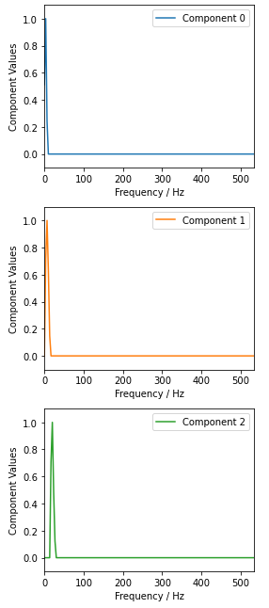
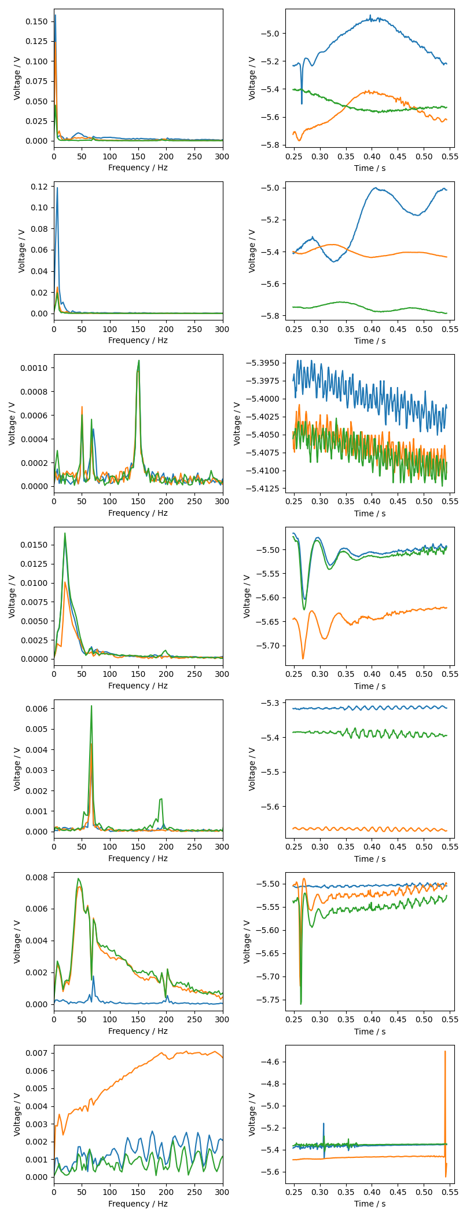
NMF Components
Component Index | Component | 3 Event Examples | Dominant Frequencies | Order of magnitude
0* |  |  | 3 Hz | 100mV
1 |  |  | 6 Hz | 100mV
2 |  |  | 20 Hz | 10mV

Slide 13
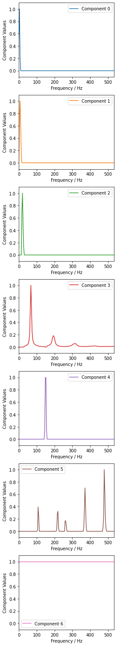
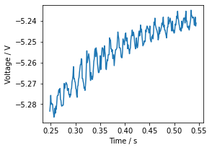
Component Index | Component | 3 Event Examples | Dominant Frequencies [Hz] | Order of magnitude
3 |  |  | 67 Hz 184 Hz 302 Hz | 100mV
4 |  |  | 148 Hz | 1mV
5 |  |  | 107 Hz 220 Hz 260 Hz 370 Hz 478 Hz | 0.1mV
6 |  |  | Any | 100mV

Slide 14
Causal Discovery
Understand normal behavior

Slide 15
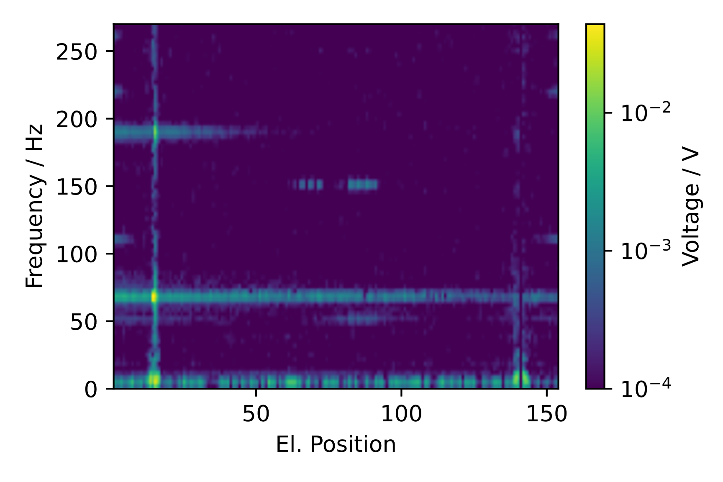
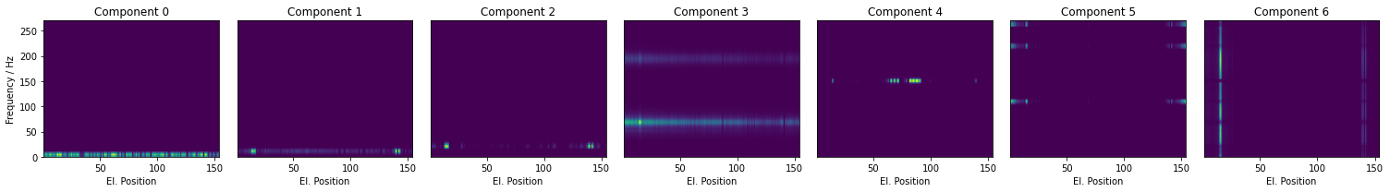







Causal Discovery
Normal event
Frequency components along all magnets in event
$$≈$$
$$+$$
$$+$$
$$+$$
$$+$$
$$+$$
$$+$$
3Hz
6Hz
20Hz
65Hz
143Hz
478Hz
Offset
Electromagnetic perturbation + FFT smiring
Source Direction: Quench
Propagation: Physical
Electromagnetic perturbation
Source Direction: Quench
Propagation: Physical
Left over of voltage wave traveling along the chain of magnets by magnet inductance
Source Direction: Quench
Propagation: Physical
Oscillations caused by quench
Source Direction: Quench
Propagation: Electrical
Repetitive pattern within QPS crate, aliasing?
Source Direction: Quench
Propagation: QPS crate position
Oscillations from the direction of Power converter in RB.A78, aliasing?
Source Direction: Power converter in RB.A78
Propagation: Physical
Oscillations caused by quench
Source Direction: Quench
Propagation: Physical

Slide 16
Outlier Detection
Detect abnormal behavior

Slide 17
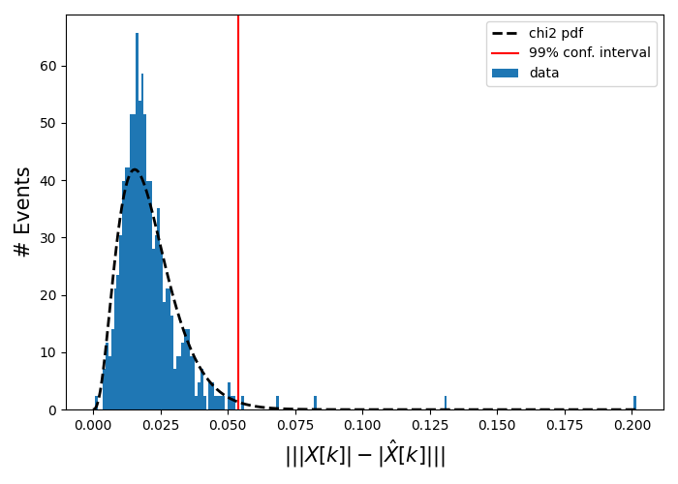
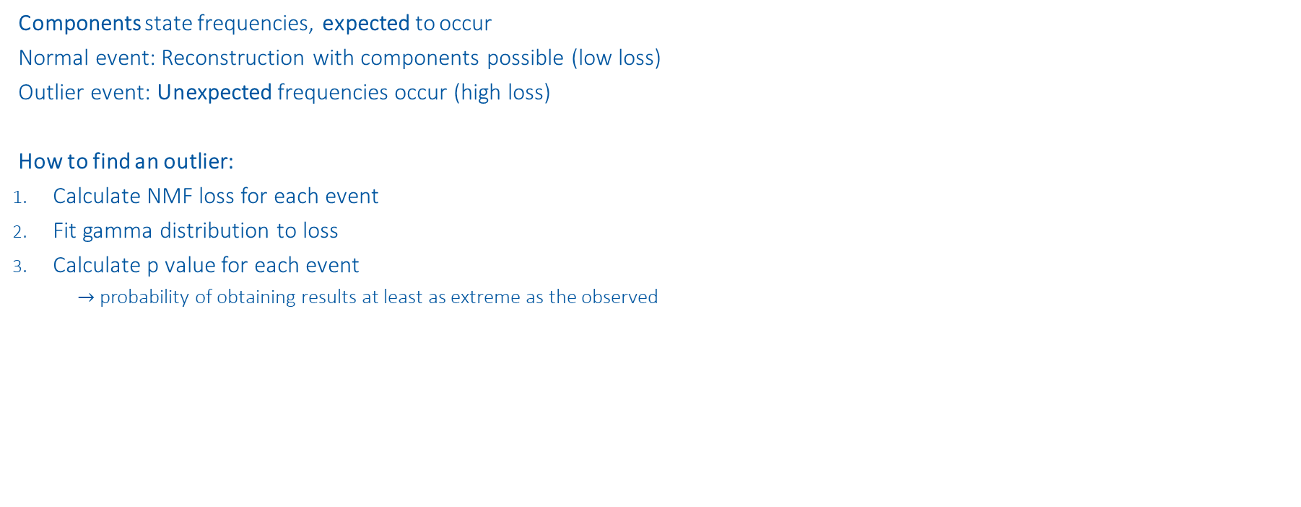
Outlier Detection
Normal event
Components state frequencies, expected to occur
Normal event: Reconstruction with components possible (low loss)
Outlier event: Unexpected frequencies occur (high loss)
How to find an outlier:
Calculate NMF loss for each event
Fit gamma distribution to loss
Calculate p value for each event
$→$probability of obtaining results at least as extreme as the observed
Outliers
Normal

Slide 18
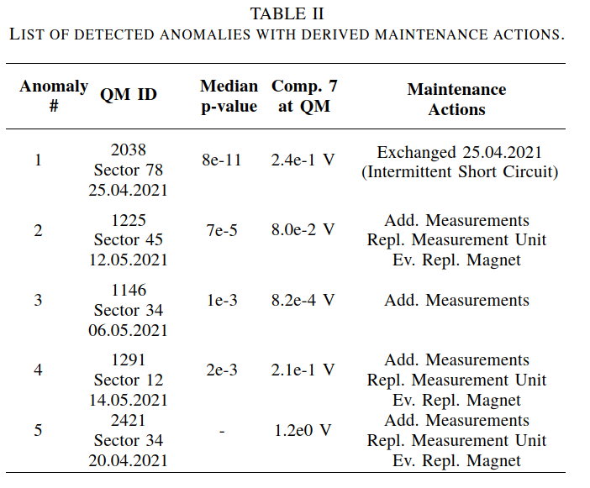
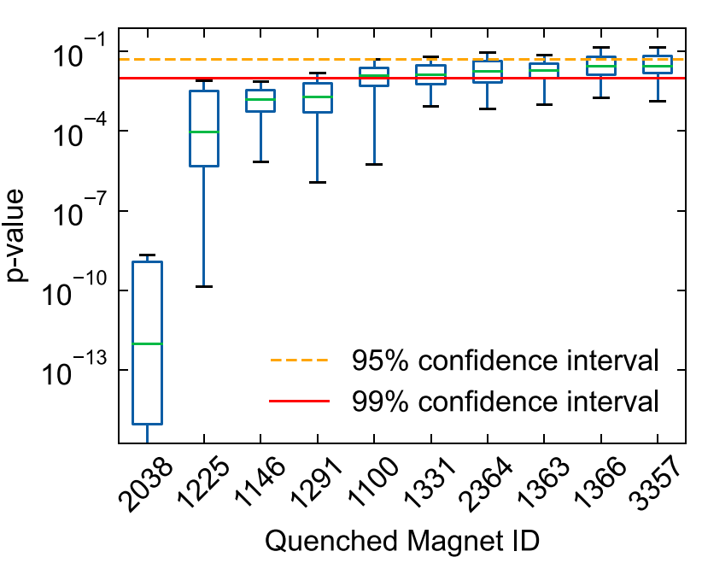
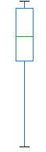
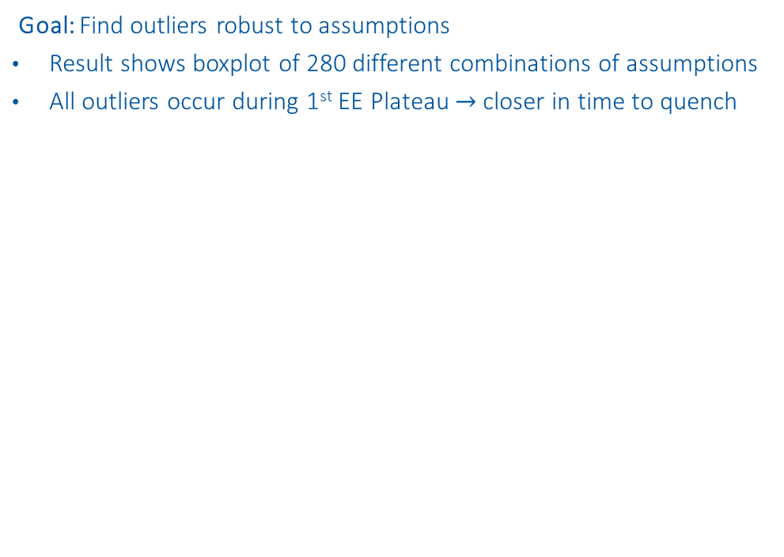
Outliers
Goal: Find outliers robust to assumptions
Result shows boxplot of 280 different combinations of assumptions
All outliers occur during 1st EE Plateau $→$closer in time to quench
Q3 + 1.5 * Box length
3rd Quantil (Q3)
Box
length
Median
1st Quantil (Q1)
Q1 - 1.5 * Box length

Slide 19
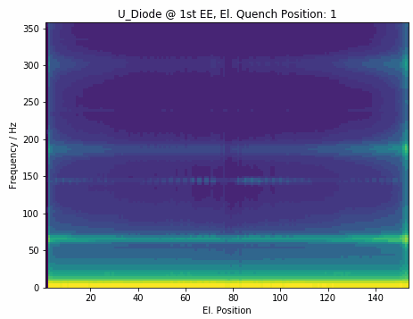
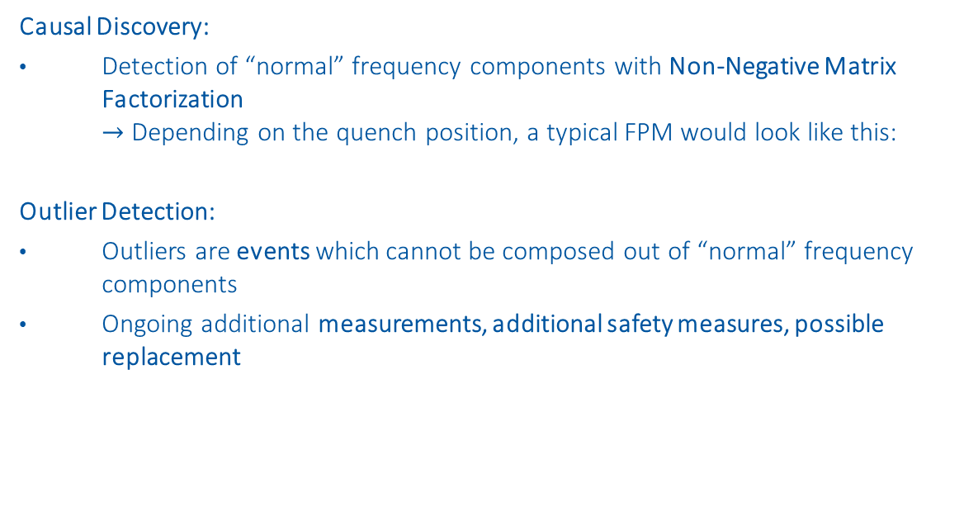
Conclusion
Causal Discovery:
Detection of “normal” frequency components with Non-Negative Matrix Factorization $→$ Depending on the quench position, a typical FPM would look like this:
Outlier Detection:
Outliers are events which cannot be composed out of “normal” frequency components
Ongoing additional measurements, additional safety measures, possible replacement

Slide 20
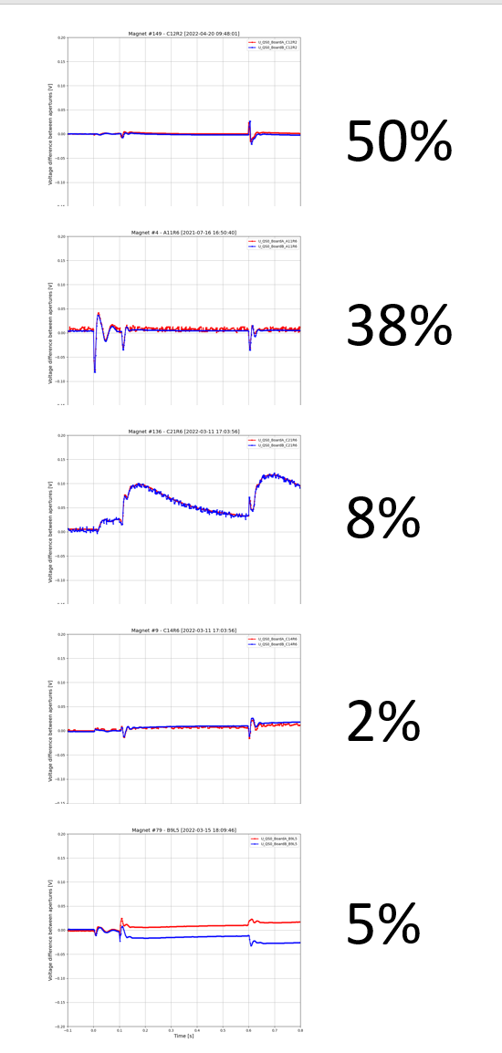
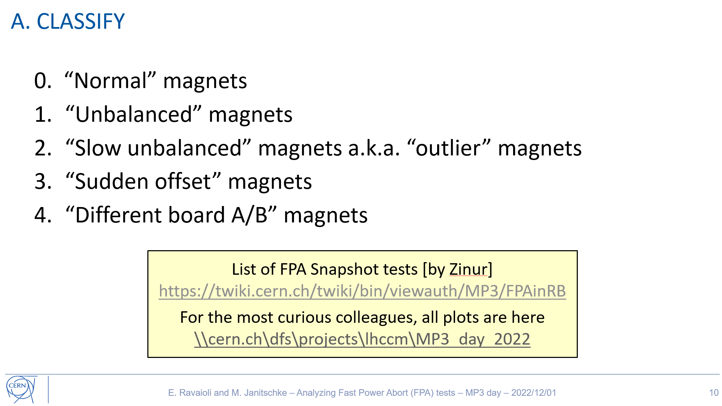
Next Steps
Understand where experts can profit from data analysis!
Ongoing ML projects:
U_diode NXCALS data
Investigation of secondary quenches
mb-feature-classification
Make decisions: Gather RB machine parameters and analysis results
Find correlations with ML
UQS0 signal classification
Classify ~35000 UQS0 signals from snapshot FPAs similar as experts
80% of signals are classified similarly
In the remaining 20%, ML was right in 90%
SOH prediction in capacitor banks
Assisting Timm Baumann SY/EPC

Slide 22
Backup Slides

Slide 23
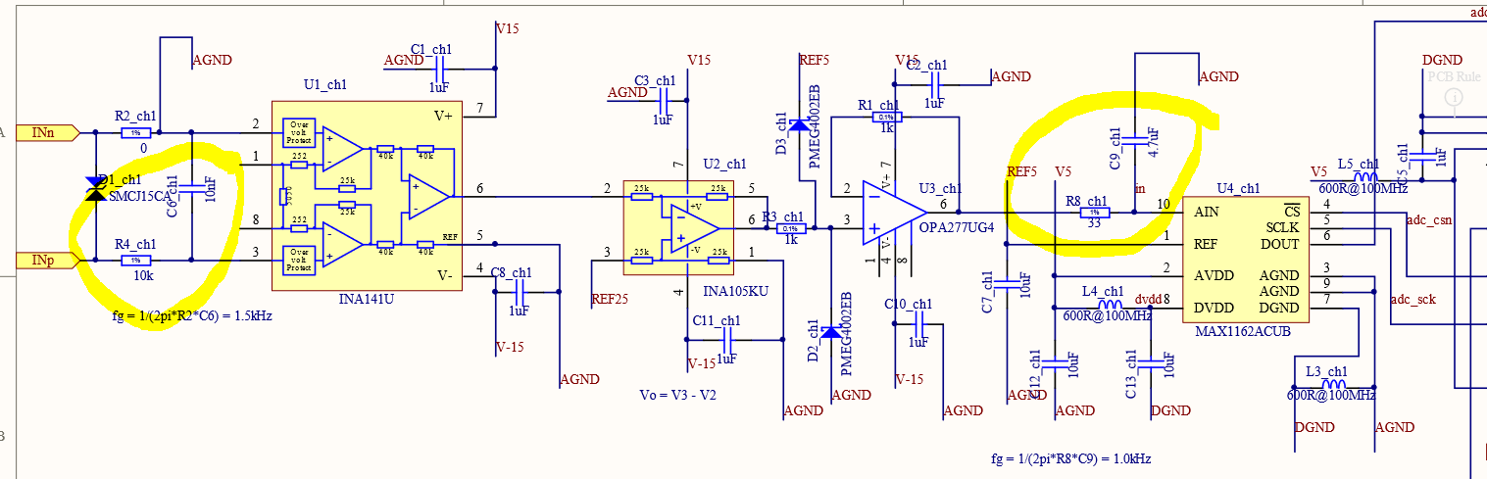
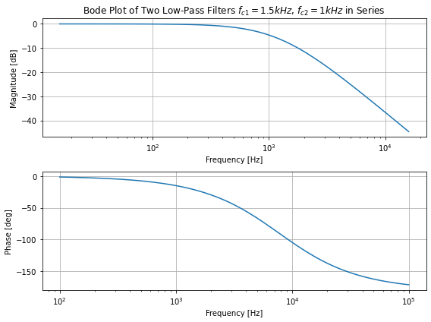
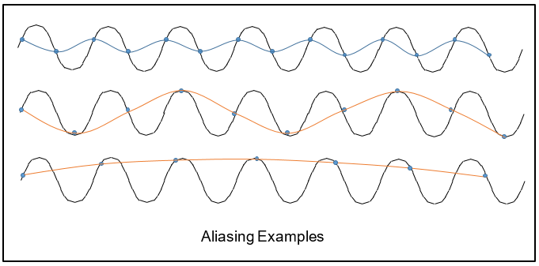
Aliasing
1.5kHz 1st Order lowpass direkt am Eingang und dann noch einen zweiten mit 1kHz vor dem ADC
High frequency components could potentially cause aliasing in results.
Anti-aliasing filters in the nQPS crates:
Two 1st order lowpass filters with 1.5 kHz and 1 kHz cutoff frequency*
Sampling frequency of nQPS crates: 1068 Hz
*provided by Jens Steckert

Slide 24
Fast Fourier transform

Slide 25
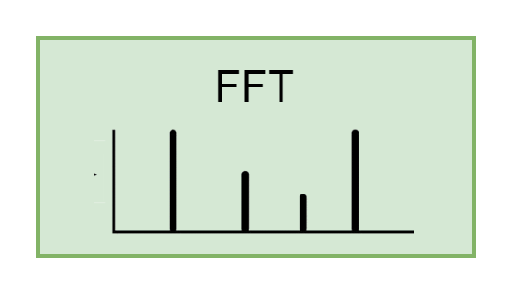
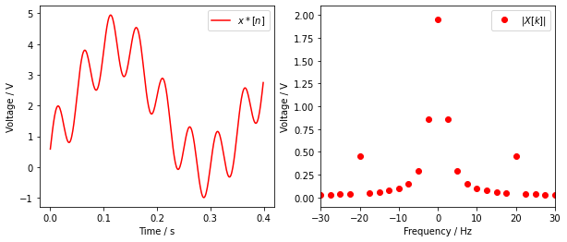
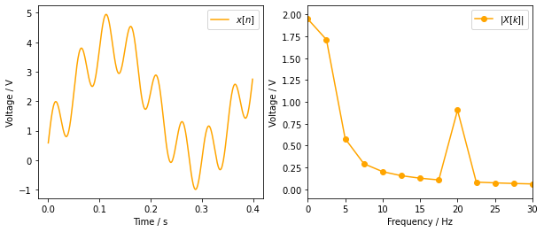
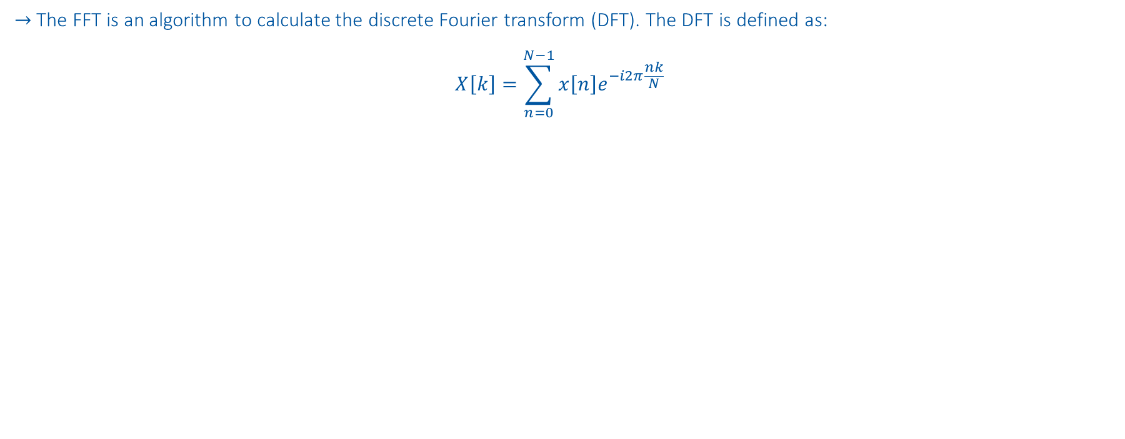
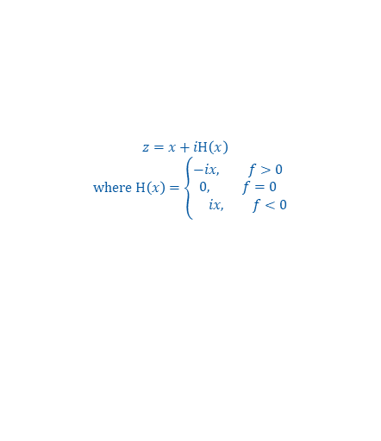
Fast Fourier transform
$→$The FFT is an algorithm to calculate the discrete Fourier transform (DFT). The DFT is defined as:
$$X\left[k\right]=\sum_{n=0}^{N−1}{x\left[n\right]e^{−i2π\frac{nk}{N}}}$$
$$x\left[n\right]=2V+2V∗sin(2π 3Hz∗n −90°) +sin(2π 20Hz∗n)$$
Apply Hilbert transform: Multiply all but first sample of FFT amplitude with 2
$z=x+iH\left(x\right)$
$$where H\left(x\right)=\left\{\begin{aligned}−i&x, f>0 \\ 0, f=0 \\ &ix, f<0\end{aligned}\right.$$
Smearing

Slide 26
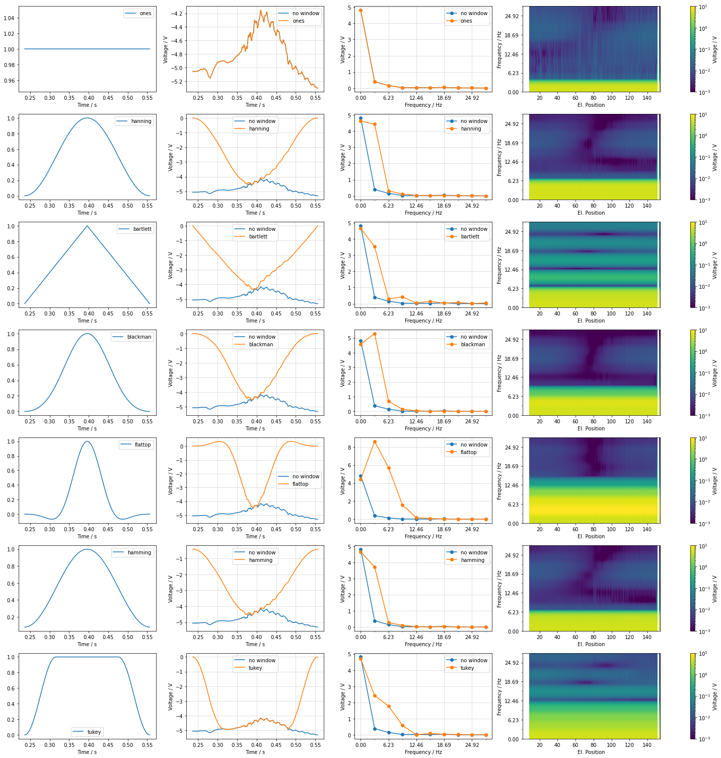
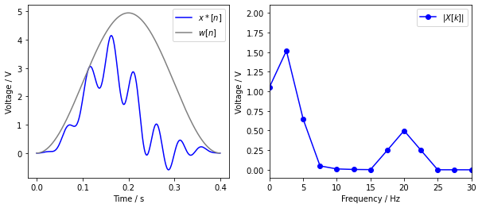



Window data
$→$ Avoid smearing
$$x\left[n\right]=2V+2V∗sin(2π 3Hz∗n −90°) +sin(2π 20Hz∗n)$$
Use Window:
$x^{∗}\left[n\right]=$ $x\left[n\right]∗w[n]$
Wrong Amplitude
Smearing
Add Window gain: Divide $|X\left[k\right]|$ with $\frac{1}{N}\sum_{n}^{N}{w[n]}$
Smearing from DC

Slide 27


Detrend data
$→$Smearing of DC component interferes with low frequency component
$$x\left[n\right]=2V+2V∗sin(2π 3Hz∗n −90°) +sin(2π 20Hz∗n)$$
Smearing from DC
Subtract trend:
$x^{∗}\left[n\right]=$ $(x\left[n\right]−{(p}_{1}n+p_{0}))∗w[n]$

Slide 28


Backwards Path
Signal: B21R3 on 2021-04-18 08:44:17
$$\frac{10 Periods}{0.15 s}=66.7 Hz$$
$$67.4 Hz$$

Slide 29
Non-Negative Matrix Factorization (NMF)
https://www.nature.com/articles/44565
https://proceedings.neurips.cc/paper/2000/file/f9d1152547c0bde01830b7e8bd60024c-Paper.pdf

Slide 30









Objective Function
$$V≈ WH$$
$m …$ number of $i$events * positions (560 x 154)
$n …$ number of frequencies (0-360Hz)
$r …$ number of components (1-5)
$V∈ℝ_{+}^{n×m}$… reconstructed event at position
$W∈ℝ_{+}^{n×r}$… components
$H∈ℝ_{+}^{r×m}$… presence of components
NMF Objective Function:
$\underset{W,H}{\min{ }}f\left(W, H\right)≡\frac{1}{2}{\left\|V−WH\right\|}_{F}^{2}$, s.t. $W, H≥0$
$$≈\sum_{k=1}^{r}{ }$$
$$⋅$$
$$=\sum_{k=1}^{r}{ }$$
$$=$$
$$⋅$$
$$⋅$$
$$⋅$$
$$⋅$$

Slide 31


Backwards Path
Signal: B21R3 on 2021-04-18 08:44:17

Slide 32
Causal Discovery

Slide 33
El. Vs Phys. Position

Slide 34

U-diode frequencies
Input
3Hz
6Hz
20Hz
66Hz
150Hz
478Hz
offset

Slide 35

Overview

Slide 36





3Hz

Slide 37






3Hz Examples
Quenched Magnet: C17L5 (Manufacturer 1)
Quenched Magnet: A32L4 (Manufacturer 1)
Quenched Magnet: B11L2 (Manufacturer 1)
Quenched Magnet: C32L2 (Manufacturer 1)
RB_RB.A12_1619462088820000000_2021-04-26
Quenched Magnet: C14L2 (Manufacturer 1)
RB_RB.A12_1619935955860000000_2021-05-02
Quenched Magnet: B33R4 (Manufacturer 1)
RB_RB.A45_1620232873800000000_2021-05-05

Slide 38




6Hz

Slide 39





20Hz

Slide 40





20Hz
QH
$$↓$$
Diode
$$↓$$
1/0.05=20Hz

Slide 41




66Hz

Slide 42



150Hz
EE switch
EE switch
EE switch
It actually starts 1 QPS crate after the EE switches

Slide 43



478Hz
(df["no_sec_q"] == 1) & (df["Circuit_RB.A78"] == 1)
24480 signals
No Oscillations
@ Snapshots 11 kA, 10A/s

Slide 44


Offset

Slide 45


Offset
QH
$$↓$$
Diode
$$↓$$
1/0.05=20Hz

Slide 46
Outlier Detection

Slide 47
Assumptions
Assumptions for this plot:
Linear detrend
Hamming window
4 components
Frobenius distance
Preprocessing:
Degree of detrend:
0 - Offset
1 - Linear Trend
Window multiplication:
none (best reconstruction, high smearing)
hanning (lowest smearing, no reconstruction)
hamming (low smearing , good reconstruction)
barlett
blackman
flattop (high smearing, accurate amplitude)
tukey
NMF:
n_components (2-12)
Distance measure*:
Frobenius (Eu)
Kullback-Leibler (KL)
280 x
* https://ieeexplore.ieee.org/stamp/stamp.jsp?arnumber=6410389

Slide 48


2038 - RB.A78 - B28L8 – Intercoil short
Event with B28L8 quench before:
2021-03-28: „normal“ at EE plateaus

Slide 49

1225 - RB.A45 - C17L5
Events with C17L5 quench before:
2021-05-07: „normal“ at EE plateaus
2021-05-07: „normal“ at EE plateaus
A17L5, E89
B16L5, E88
C16L5, E66

Slide 50

1146 - RB.A34 - A32L4
Events with A32L4 quench before:
2021-04-04: „normal“ at EE plateaus
2021-04-14: 3 fast sec. quenches
B33A4, E36
B33L4, E118
C32L4, E119
B32L4, E35

Slide 51

1291 - RB.A12 - B11L2
No B11L2 quench before
A11L2, E4
B10L2, E152
A9L2, E3
B9L2, E153

Slide 52
2421 - RB.A34 – B28R3
No B28R3 quench before
Most likely scenario of noise from simulations:
Partially emerging resistor, in parallel to diode
Degraded diode contact?

